Slide 1
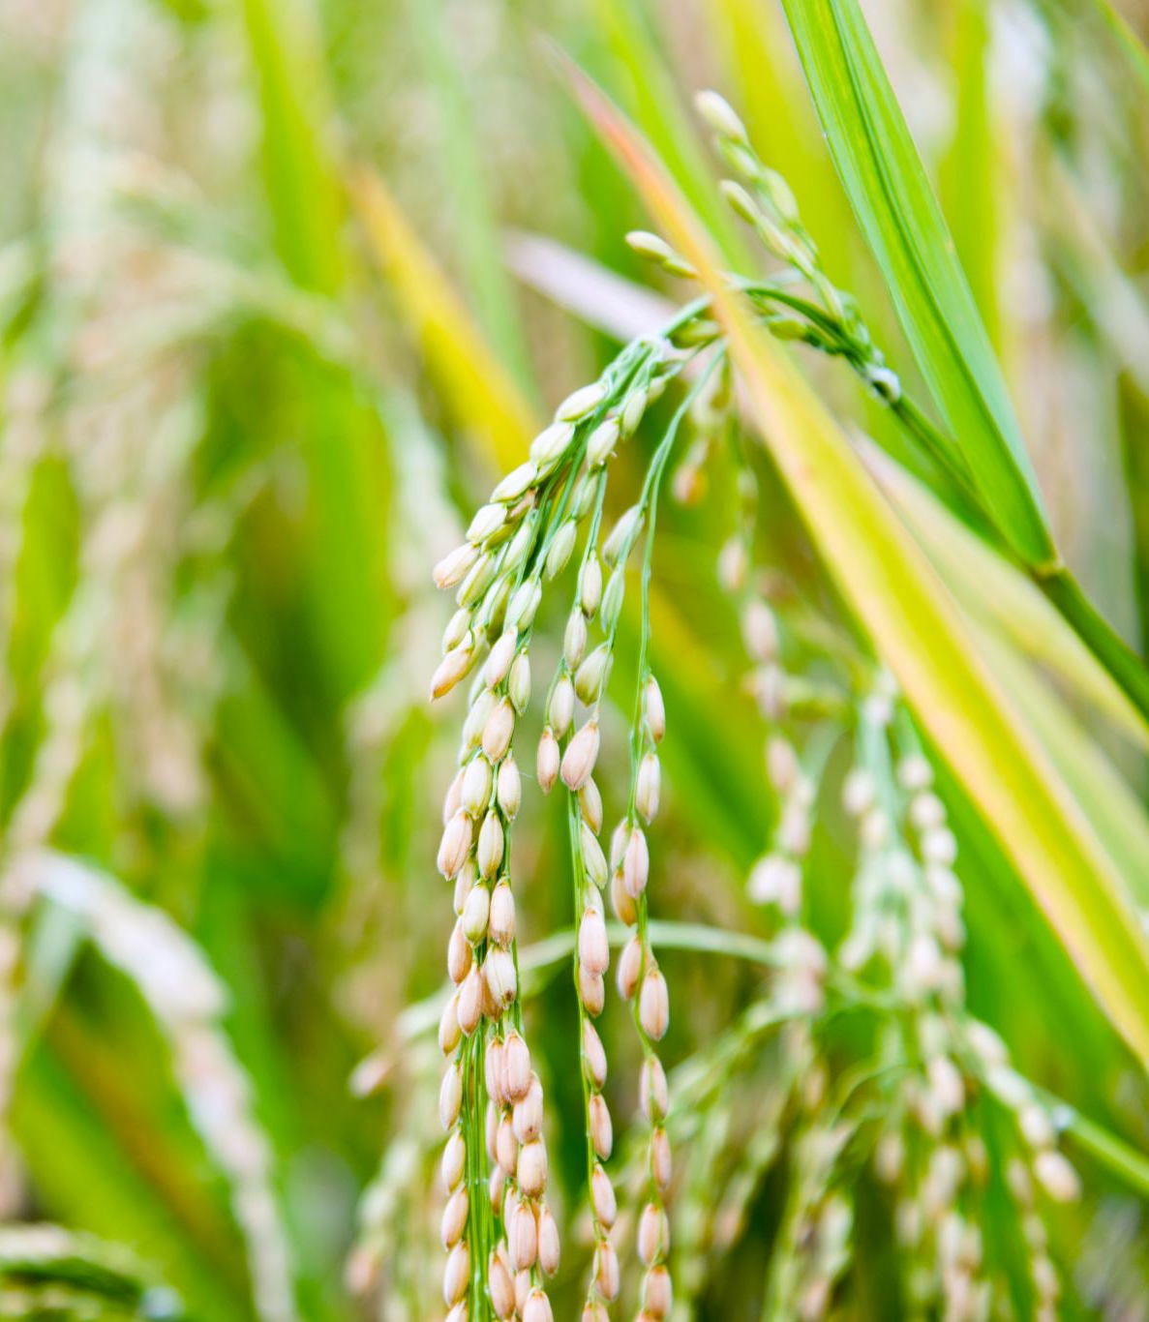
RICE VARITY IN BD Analysis
Machine Learning
Semester: FALL 2025
CSE475 Section:2
Notes:
AI-generated content may be incorrect. ---

Slide 2
Submitted By
Name: Farhatun Nahar Priya
ID-2023-1-60-202
Name: Nuran Farhana Prova
ID-2023-1-60-075
Name: Afsana Akter Mim
ID-2023-1-60-073
Submitted To
Dr. Raihan Ul Islam,
Associate Professor
Department of ComputerScience and Engineering
Notes:
Project Overview

Slide 3
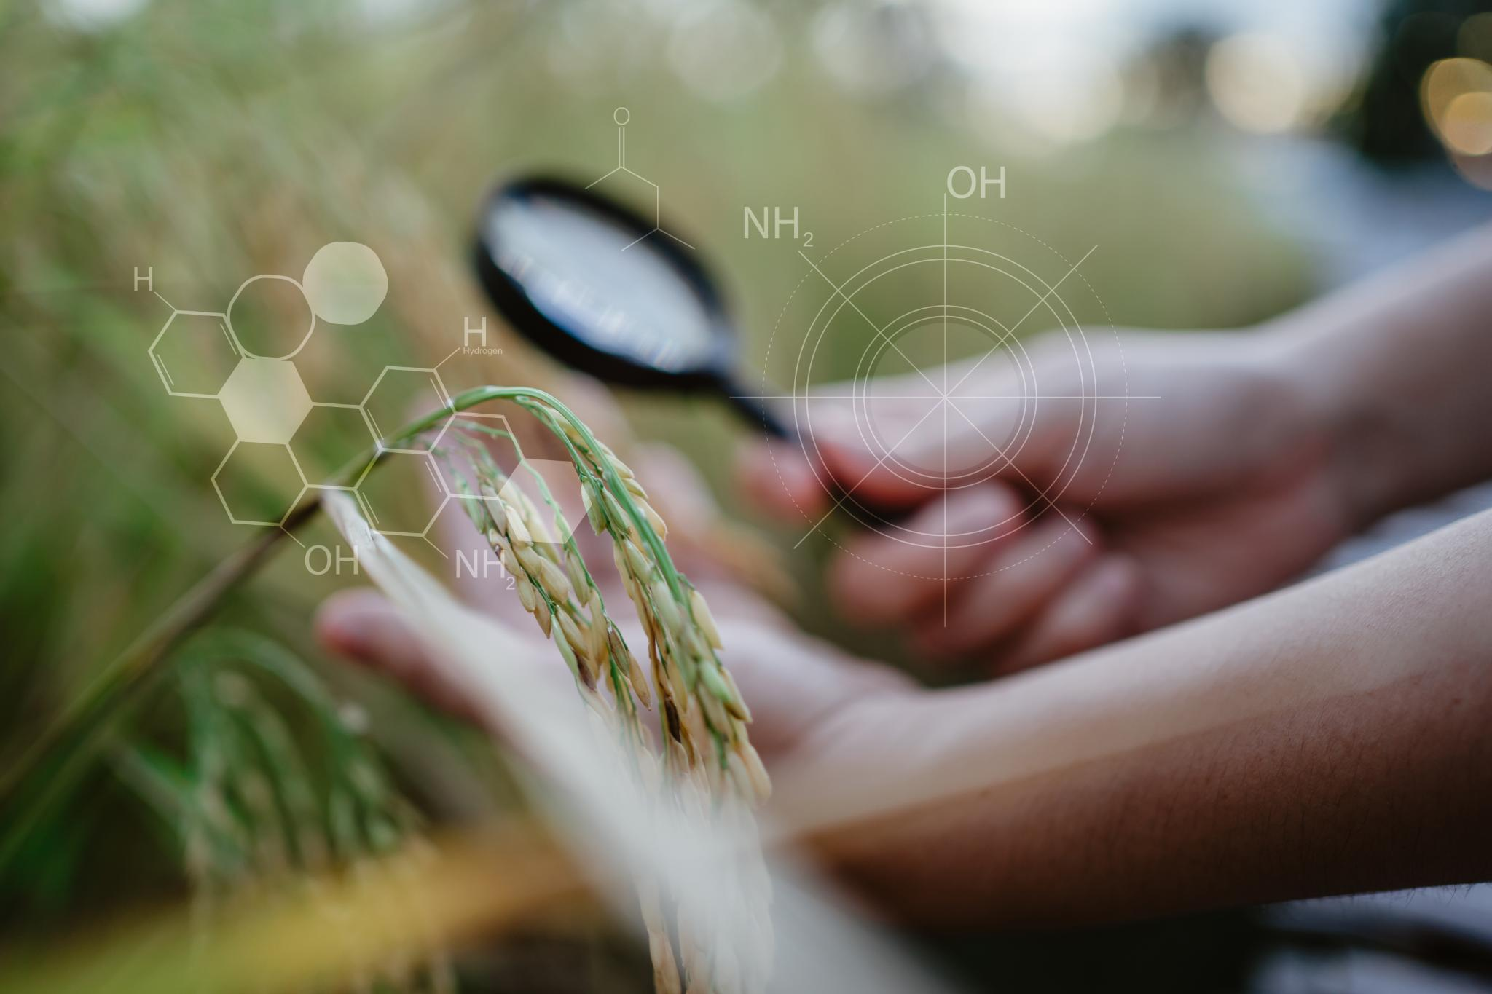
Project Overview
Evaluate and compare the performance of self-supervised learning frameworks(SimCLR, BYOL, and MAE )on the PRDB dataset using backbone architectures DenseNet-121 and ViT.
Evaluate supervised pretraining performance on the PRDB dataset with NASNetMobile, ConvNeXt-Tiny, InceptionV3, ResNet-50, and DenseNet-121 models.
Notes:
Rice is one of the most important staple foods globally, and understanding its varieties is crucial for agriculture, trade, and food security. This project focuses on classifying processed rice varieties using machine learning techniques. The primary objective is to develop a model that can accurately identify different rice types based on microscopic images and RGB histogram features. By leveraging image processing and supervised learning, the system aims to automate classification tasks that traditionally require expert knowledge. This approach not only saves time but also ensures consistency in quality control. The project involves collecting a dataset of rice grains, preprocessing images, extracting relevant features, and training a machine learning model to predict the variety. The ultimate goal is to demonstrate how AI can assist in agricultural research and industrial applications, improving efficiency and reducing human error.

Slide 4
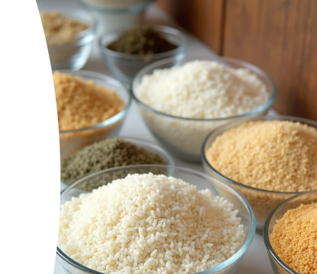
PRBD Dataset: contains 10 processed rice varieties of Bangladesh Diverse Rice Varieties Dataset Size: 10,000 images
(2,000 original microscopic images + 8,000 augmented images)
Physical Grain Characteristics
Rice grains are characterized by shape, size, and surface texture visible in microscopic images RGB Histogram Features
RGB histograms quantify color distribution and are used as primary features for classification.
Balanced Dataset for Robustness
A balanced dataset ensures effective learning and generalization of the classifier to unseensamples.
Notes:
Rice Varieties and Image Characteristics

Slide 5
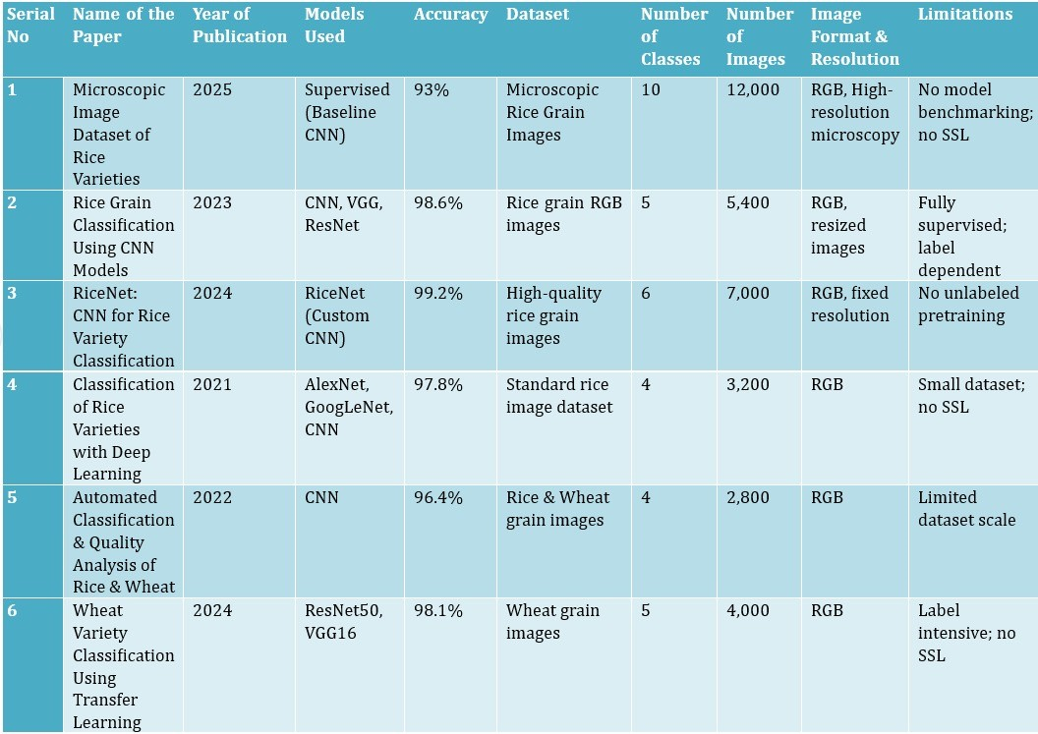
Related Work

Slide 6
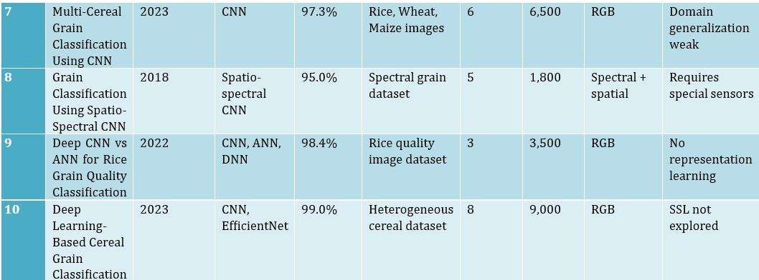

Slide 7
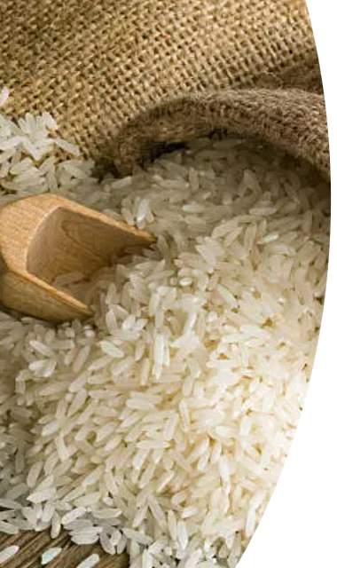
Model Architectures
SimCLR (contrastive learning with positives and negatives)
BYOL (positive pair consistency, no negatives)
MAE(masked image reconstruction) Backbones: DenseNet-121, Vit
Notes:
The dataset consists of microscopic images of 10 distinct rice varieties: Aush, BR-28, BR-29, Beroi, Chinigura, Ghee Bhog, Katari Najir, Katari Siddho, Miniket, and Swarna. Each image captures the unique physical characteristics of the grains, such as shape, size, and surface texture. These images are processed to extract RGB histograms, which serve as the primary features for classification. RGB histograms provide a quantitative representation of color distribution, which is essential because different rice varieties exhibit subtle color variations under microscopic observation. The dataset is carefully curated to ensure balanced representation of all classes, enabling the model to learn distinguishing features effectively. This diversity in the dataset is critical for building a robust classifier that can generalize well to unseen samples.

Slide 8
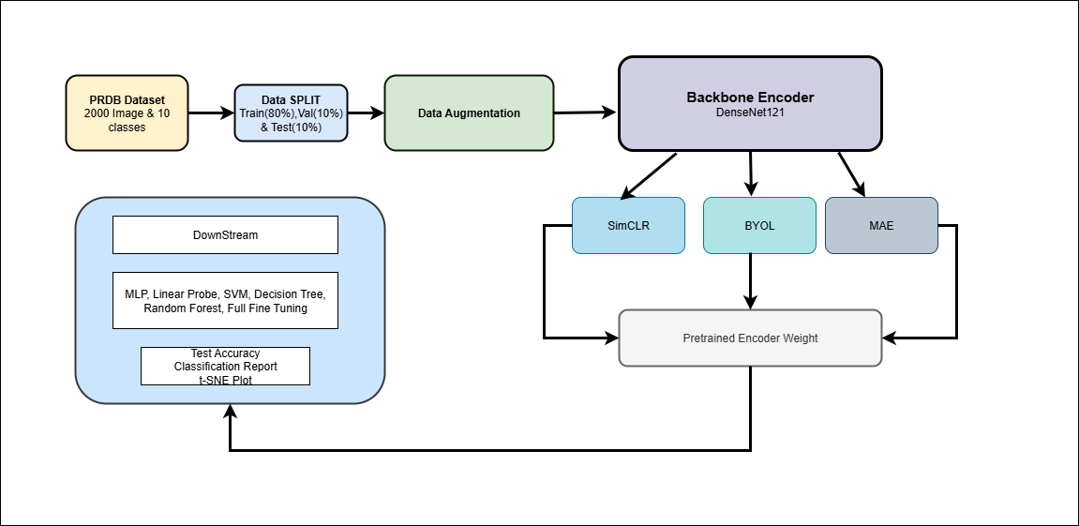
WorkFlow Diagram
Notes:
Process Flow Diagram

Slide 9
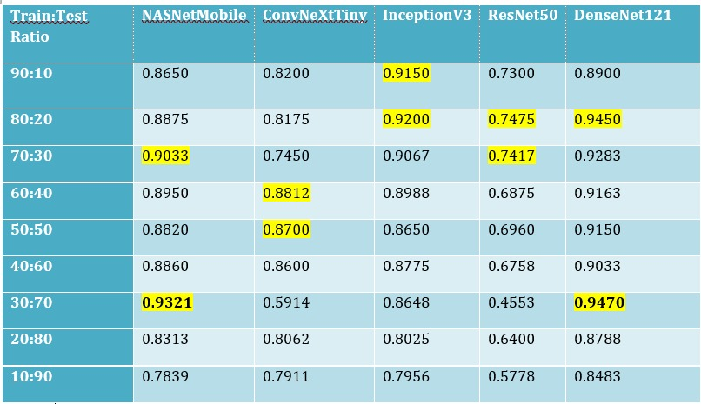
Performance Table

Slide 10
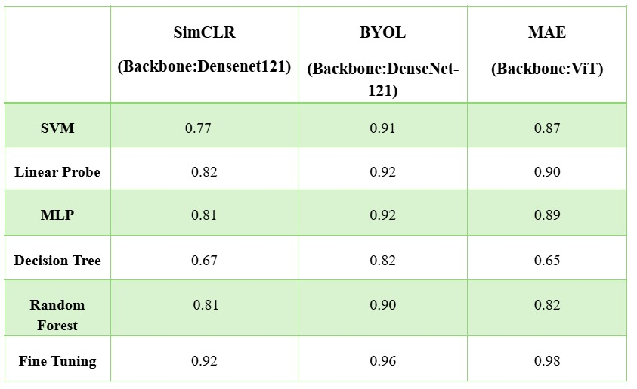
Accuracy Comparison of Models

Slide 11
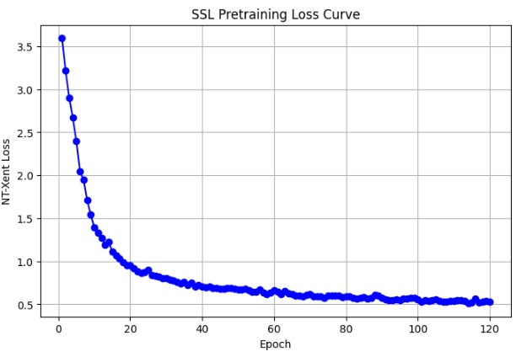
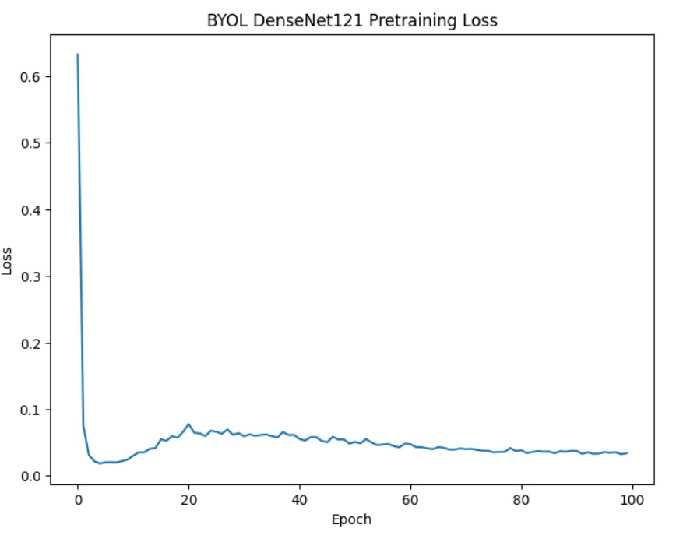
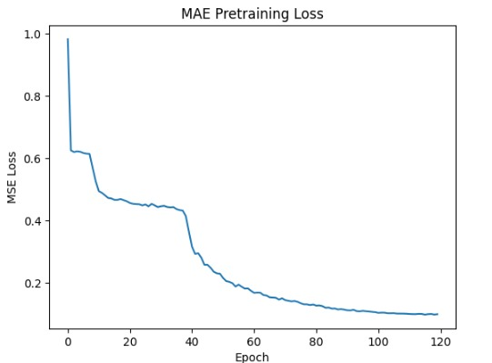
LOSS cURVE
Notes:
Performance Metrics

Slide 12
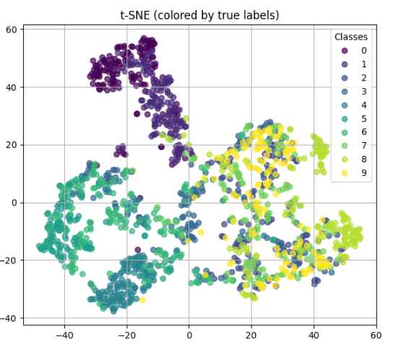
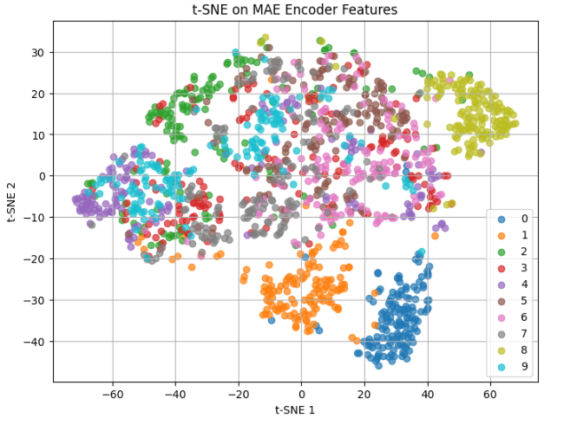
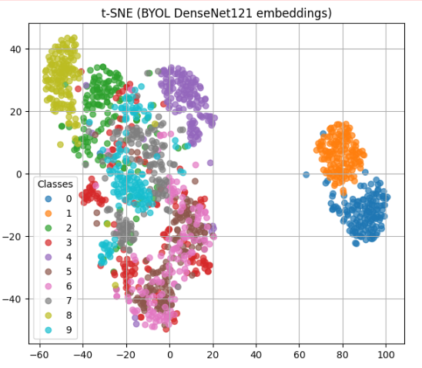
t-SNE PLOT
SimCLR
MAE
BYOL

Slide 13
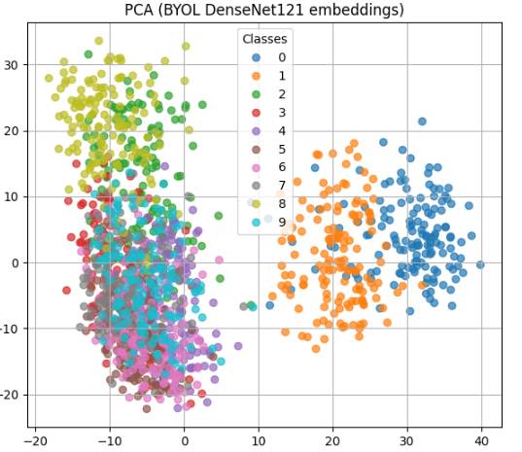
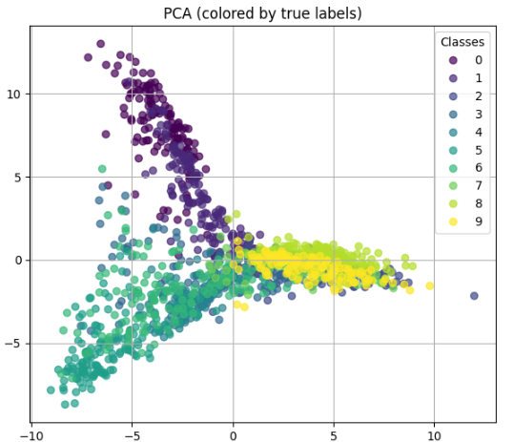
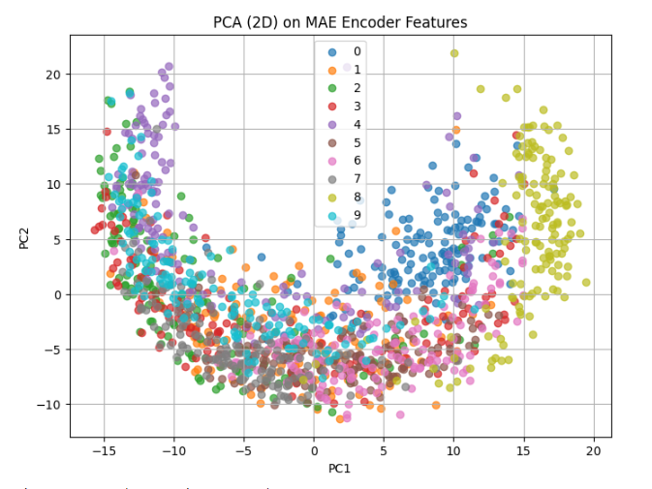
PCA PLOT

Slide 14

Notes:
Key Findings and Next Steps

